Slide 1
Installation Process for VSDFlow
Created By: Group - 4
Tirth Chauhan
Shahid Chopda
Nandni Vajani
Hani Prajapati
Harsh Kapadiya
Date:16/07/2024
A Step-by-Step Guide

Slide 2
Introduction
Vsdflow is a tool designed for the VLSI (Very Large Scale Integration) physical design process, which involves the transformation of a high-level design into a detailed physical representation that can be fabricated on a semiconductor chip. This tool is used by engineers to streamline and optimize the various stages of physical design, ensuring efficient and reliable chip manufacturing.
Vsdflow: Key Features and Capabilities
Floor planning
Placement
Routing
Clock Tree Synthesis (CTS)
Timing Analysis and Optimization
Power Analysis and Optimization
DRC and LVS Verification
Signoff and Tape out

Slide 3

PREREQUISITES
Hardware Requirements: Minimum and recommended system specifications for running vsdflow on Ubuntu with VM.
Software Requirements: Windows OS, virtualization software (e.g., VirtualBox or VMware), Ubuntu ISO file.

Slide 4
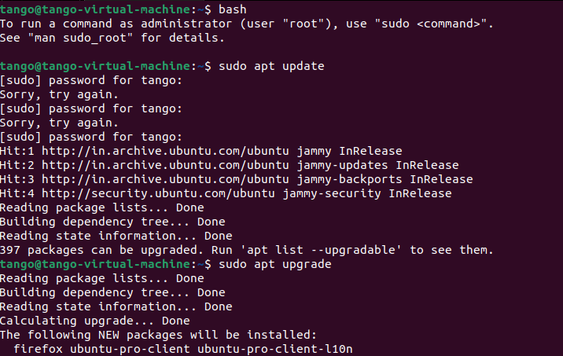
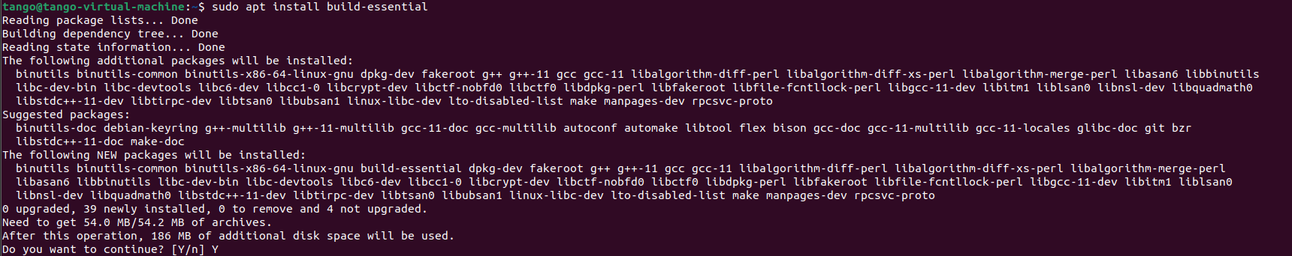
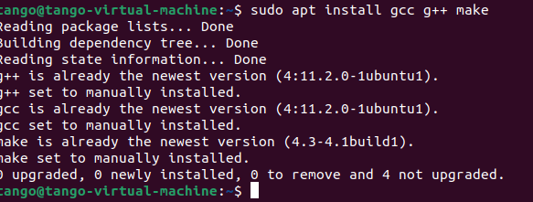
UPDATING UBUNTU
Step 1
Open the terminal and run:
Run below listed commands
bash
sudo apt update
sudo apt upgrade
Step 2
Installing Essential Tools:
Run below listed commands
bash
sudo apt install build-essential
sudo apt install gcc g++ make
*Bold text indicates commands

Slide 5
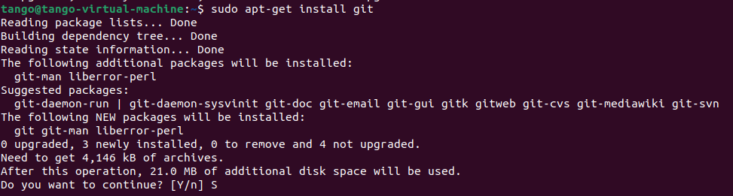
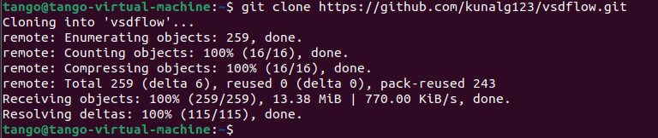
Git installation and Repository cloning
Step 1
Installation Of git :
Run below listed commands
sudo apt-get install git
Step 2
Cloning Repository :
Run below listed commands
git clone https://github.com/kunalg123/vsdflow.git

Slide 6
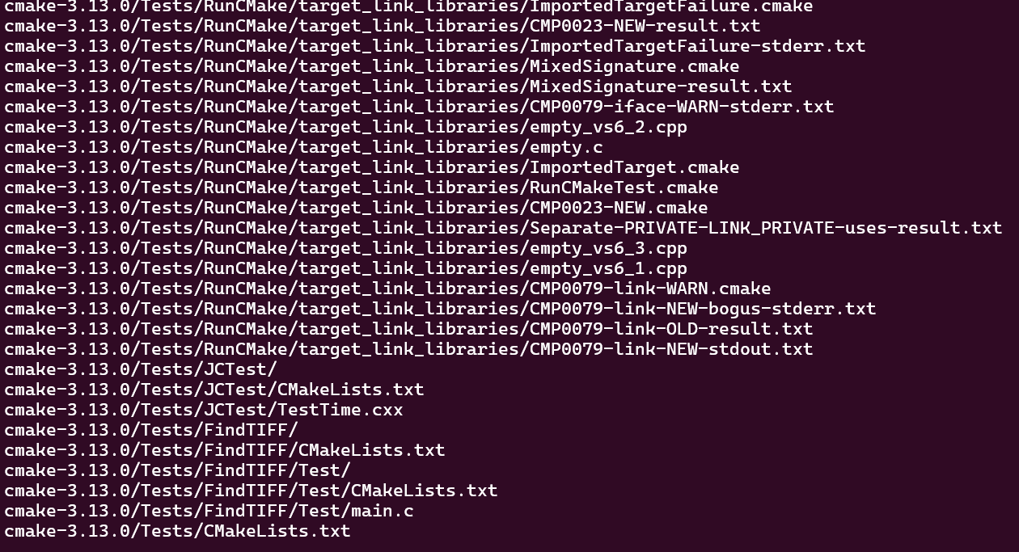
installation
Step 1
Getting in to vsdflow directory:
Run below listed commands
cd vsdflow
Step 2
Changing permission to read, write and execute:
Run below listed commands
chmod 777 opensource_eda_tool_install.sh
Step 3
Executing script “opensource_eda_tool_install.sh”
Run below listed commands
./opensource_eda_tool_install.sh

Slide 7
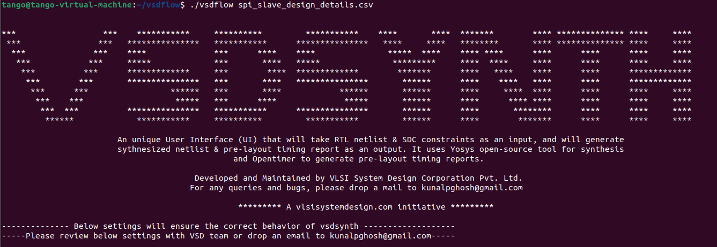
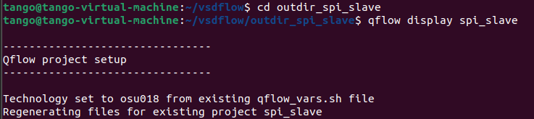
Verification and Testing
Running a Test Project:
Step 1
Running vsdflow with test project:
Run below listed commands
./vsdflow spi_slave_design_details.csv
Step 2
Directing into output Directory:
Run below listed commands
cd outdir_spi_slave
Step 3
Open Project in qflow:
Run below listed commands
qflow display spi_slave

Slide 8
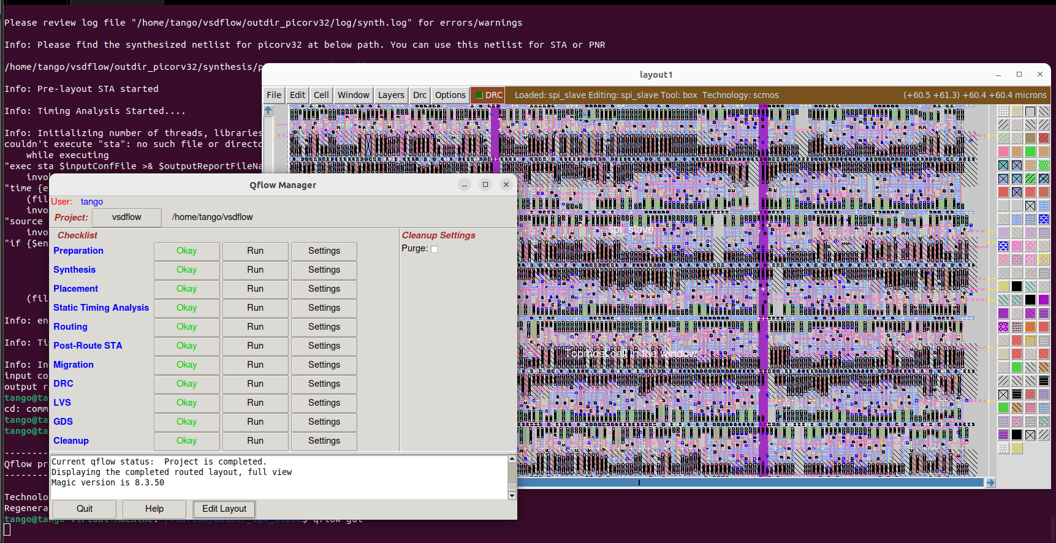
QFLOW GUI

Slide 9
Overview of vsdFlow Tools
1. Yosys - RTL Synthesis
Converts RTL to gate-level netlist; optimizes performance/area.
2.blifFanout - High Fanout Net (HFN) Synthesis
Manages high fan-out nets for better timing and reduced congestion.
3.graywolf - Placement
Places standard cells; minimizes wire length and congestion.
4.qrouter - Detailed Routing
Connects cells with metal layers; ensures DRC compliance.
5.magic - VLSI Layout Tool
Layout editing/visualization; DRC and LVS verification.
6.netgen - Layout vs. Schematic (LVS)
Compares layout with schematic; identifies discrepancies.
7.OpenTimer and OpenSTA - Static Timing Analysis (STA) Tools
Ensures design meets timing requirements; identifies critical paths.

Slide 10
Resources
For Vsdflow Installation:
Git : https://github.com/kunalg123/vsdflow/blob/master/README
YouTube : https://www.youtube.com/watch?v=tn64OU1GA7I
For Ubuntu Setup On VMware:
YouTube : https://www.youtube.com/watch?v=SgfrHKg81Qc

